Slide 1
2B Tutorial 2 – Semester 2 2019
20 August 2019

Slide 2
Agenda – Tutorial 2
Chief Examiner – William Zheng
    Exam Technique
Capital
    Overview of capital framework in Australia
    Capital Base and Types of Capital
    Prescribed Capital Amount
    Internal Capital Adequacy Assessment Process
Capital in action – AMP’s Full Year 2016 results
Analysis of Earnings - example

Slide 3

(My Exam Technique)
    Time management – allocate correct time to questions. It’s much easier to get up to the first 6/10 than it is to get from 6/10 to 9/10.
    Underline key characteristics in the question. Then cover off all those characteristics in your answer.
    You know a lot about the topic. The question may sound confusing but try to write down a lot of your knowledge (in the context of answering the question)
    And the best preparation is doing exam questions under exam conditions.

Slide 4
Prudential Capital - Overview
    Holistic approach including Prescribed Capital and Internal Capital Adequacy Assessment Process (ICAAP)
    Encompasses many Life Prudential Standards
        LPS110 – Capital Adequacy
        LPS112 – Measurement of Capital
        LPS114 – Asset Risk Charge
        LPS115 – Insurance Risk Charge
        LPS117 – Asset Concentration Risk Charge
        LPS118 – Operational Risk Charge

Slide 5
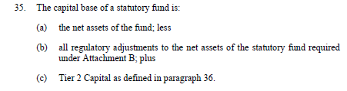
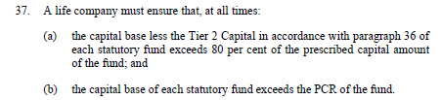
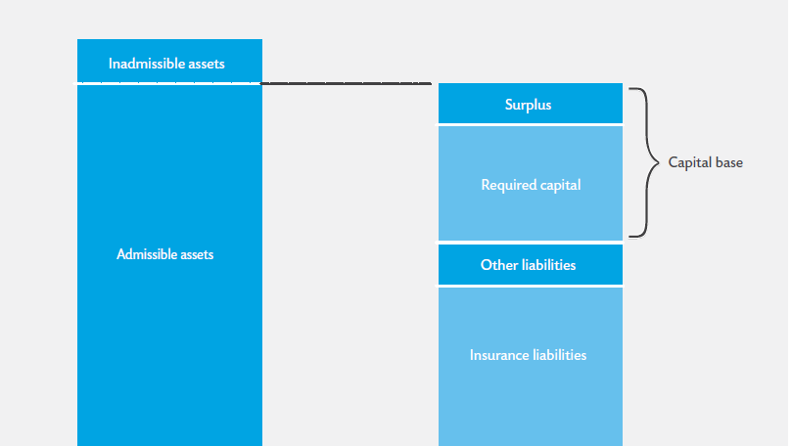
Prudential Capital – Capital Base
tier 2 can only contribute 20% of the capital at most
Regulatory Adjustments
Prudential Capital Requirement
= accounting liabilities, e.g. payable
= MOS liability = BEL + profit margin

Slide 6
Types of Capital
    Common Equity Tier 1 Capital. Includes:
    Paid-up ordinary shares
    Retained earnings
    LPS112, Attachment A has details
    Additional Tier 1 Capital:
    Still a permanent and unrestricted source of funds
    Requirement for loss absorption at the point of non-viability
    eg Hybrids (e.g. conversion to equity after a number of years; equity at the Life Company level).
    LPS112, Attachment D has details
    Tier 2 Capital:
    Requirement for loss absorption at the point of non-viability
    Eg Subordinated debt (usually includes maturity date, interest payments)
    Five years prior to maturity: “amortised” amount in Capital Base.
    LPS112, Attachment E has details.

Slide 7


Prudential Capital – Capital Base – Adjustments
    Deferred Tax Assets (LPS112 Attachment B, 8-11)
    Goodwill and Other Intangibles (LPS112 Attachment B, 13, 14)
    Reinsurance treaties not signed off! (LPS112 Attachment B, 17)
    :
    Differences between the adjusted policy liabilities and the sum of policy liabilities and policyowners’ retained profits per (LPS112 Attachment H, 22)
Biggest regulatory adjustment
‘Greater of’ generally applied at level of :
Statutory Fund
Par / Non-par

Slide 8
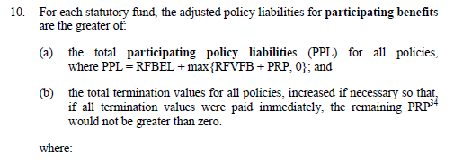
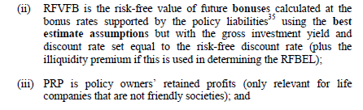
Prudential Capital – Capital Base – Adjustments
    RFBEL = Best Estimate Liability at Risk Free Rate
    Illiquidity Premium for life and term annuities, funeral bond business
    Illiquidity Premium is defined in LPS112
:

Slide 9
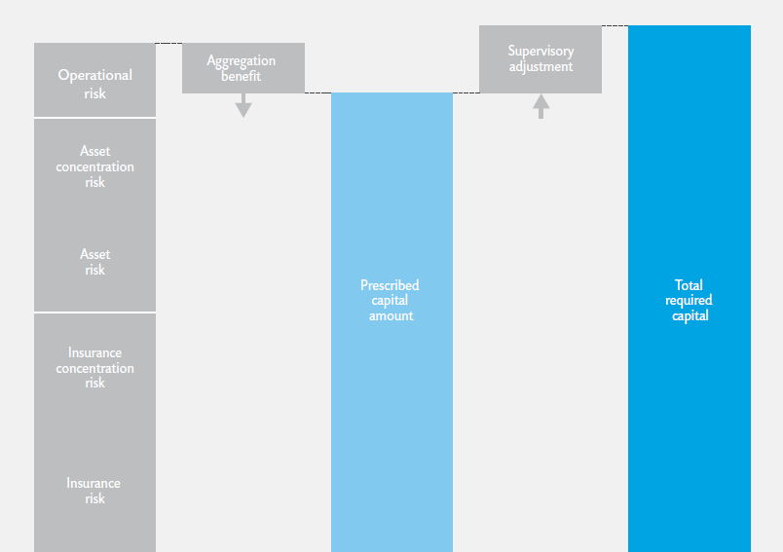
Prudential Capital – Required Capital
Prudential Capital Requirement

Slide 10
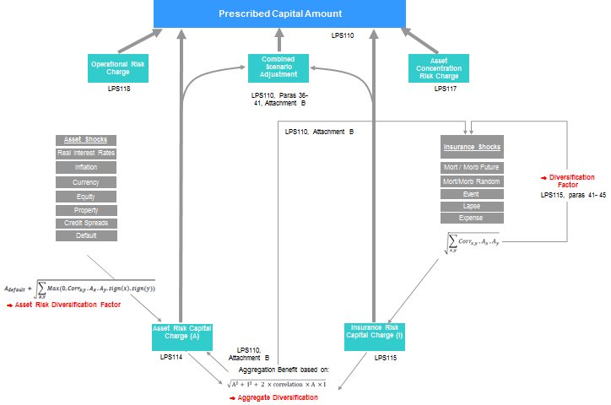
Prudential Capital – Calculation of PCA

Slide 11
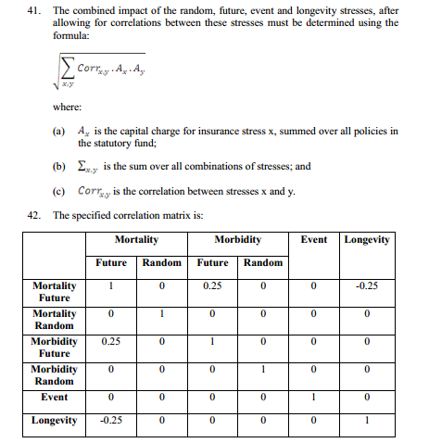

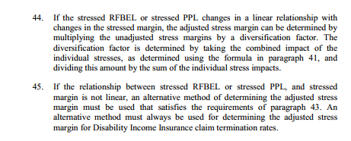
Insurance Diversification Factor – LPS115

Slide 12
Asset Risk Charge – LPS114
    Real Interest Rates
    Risk free rate up and down
    Defined in LPS114:
    Up = 0.25 x risk free rate
    Down = 0.20 x risk free rate
    Impact on Capital Base; i.e. Assets less Liabilities less Regulatory Adjustments
    Inflation
    + 125 bps; -100 bps

Slide 13
Asset Risk Charge – LPS114 (cont.)
    Equity
    Dividend yield on ASX200 up by 2.5%
    Volatility + 15%
    Property
    Rental yield up by 2.75%
    Credit Spreads
    Risk from increase and default
    Table of rates dependent on counterparty grade

Slide 14
Asset Risk Charge – LPS114 (cont.)
    Default
    Reinsurance Asset, derivatives, counterparty exposures
    Table of rates dependent on counterparty grade

Slide 15
Prudential Capital – Calculation of PCA

Slide 16
Insurance Risk Charge – LPS115
The Insurance Risk Charge for a statutory fund is the reduction, if any, in the capital base that would occur if the adjusted policy liabilities were changed to an amount equal to the stressed policy liabilities determined under this Prudential Standard.
    Mortality
    Random (12 months claims impact)
    Future (Change of assumptions: mis-estimation, trends)
    99.5% sufficiency over 12 months in the opinion of Appointed Actuary
    Morbidity
    Random; future; 99.5% sufficiency over 12 months

Slide 17
Insurance Risk Charge – LPS115
    Event
    eg Pandemic
    99.5% sufficiency over 12 months in the opinion of Appointed Actuary
    Subject to minimum of prescribed pandemic scenario
    Longevity
    20% decline in best estimate q_{x}
    Lapse
    99.5% sufficiency over 12 months in the opinion of Appointed Actuary
    Expenses
    10% increase in servicing unit costs

Slide 18
Insurance Risk Charge – LPS115
    12 month shock so allows for 12 month cashflows
    Management actions permitted but 12 month wait for premium and fee increases

Slide 19
Prudential Capital – Calculation of PCA

Slide 20
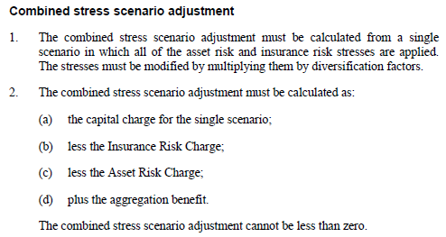
Combined Scenario Adjustment
    LPS110, Attachment B
    Captures interactive effects
    Ensures no double-count of deferred tax assets or management actions

Slide 21
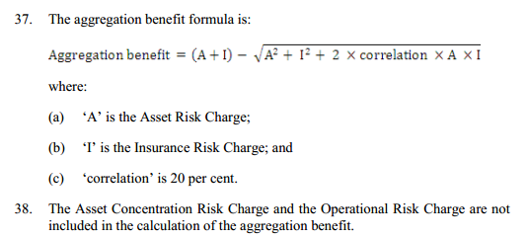
Aggregation Benefit

Slide 22
Asset Concentration Risk Charge – LPS117
    Added on to Prescribed Capital Amount
    Specified in LPS117
Operational Risk Charge – LPS118
    Broadly, for direct insurer:
    3% x Gross Premium (Risk) for risk business;
    0.25% x Adjusted Policy Liabilities for investment linked and other business
    Adjustments for growth, subject to minima
    Exact specification in LPS118

Slide 23
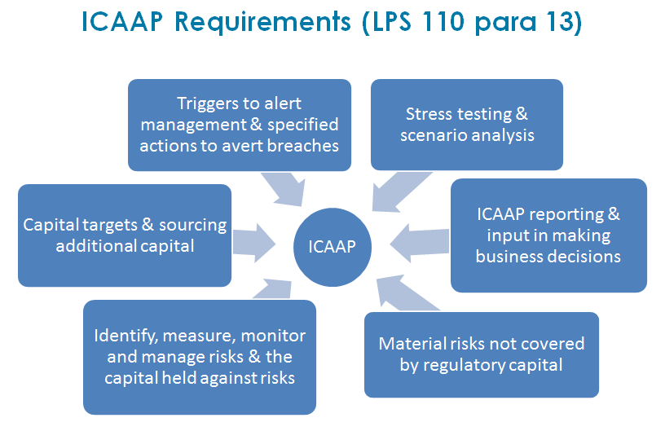
Prudential Capital - ICAAP

Slide 24
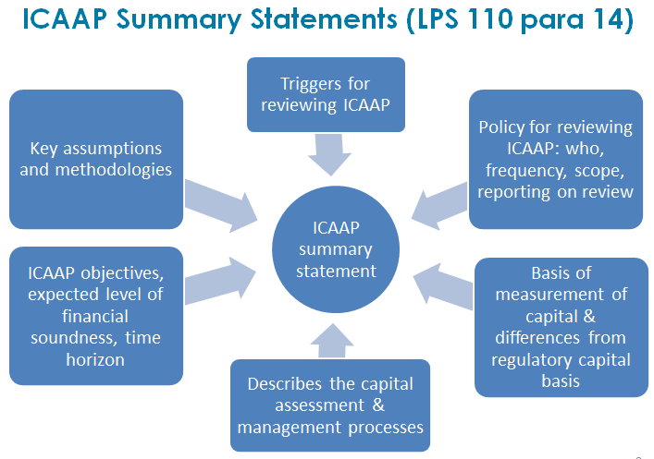
Prudential Capital - ICAAP

Slide 25
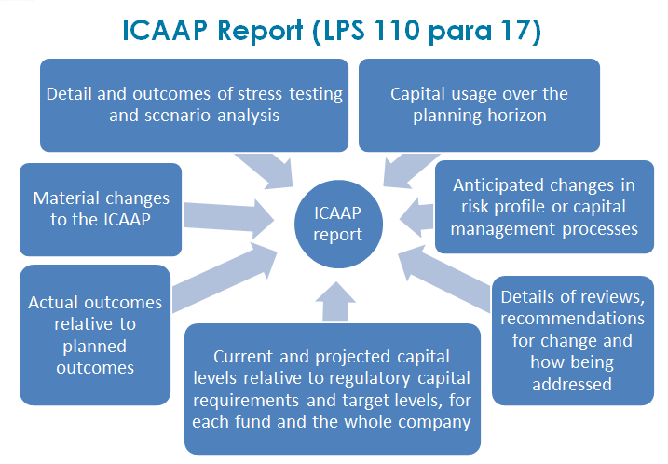
Prudential Capital - ICAAP

Slide 26
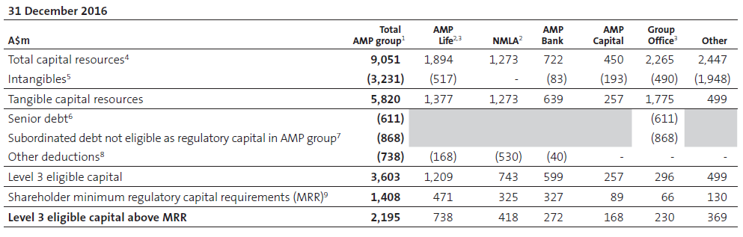
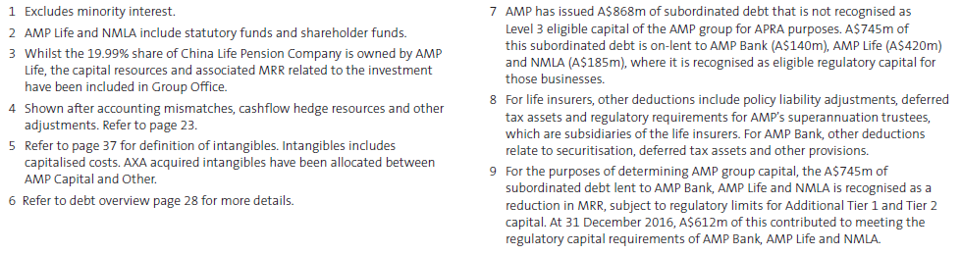
AMP Investor Report – Full Year 2016

